Slide 1
Managing Database Performance

Slide 2
Objectives
After completing this lesson, you should be able to:
  Monitor the performance of sessions and services
  Describe the benefits of Database Replay
Notes:
Oracle Database 11g: Administration Workshop II 14 - <number>

Slide 3

Tuning Activities
The three activities in performance management are:
  Performance planning
  Instance tuning
  SQL tuning
Notes:
Oracle Database 11g: Administration Workshop II 14 - <number>
Tuning Activities
The three facets of tuning involve performance planning, instance tuning, and SQL tuning.
Performance planning is the process of establishing the environment: the hardware, software, operating system, network infrastructure, and so on.
Instance tuning is the actual adjustment of Oracle database parameters and operating system (OS) parameters to gain better performance of the Oracle database.
SQL tuning involves making your application submit efficient SQL statements. SQL tuning is performed for the application as a whole, as well as for individual statements. At the application level, you want to be sure that different parts of the application are taking advantage of each other’s work and are not competing for resources unnecessarily. In this lesson, you learn about some common actions that you can take to tune specific SQL statements.
Note: For more information about performance tuning, refer to the Oracle Database Performance Tuning Guide.

Slide 4



Performance Planning
  Investment options
  System architecture
  Scalability
  Application design principles
  Workload testing, modeling, and implementation
  Deploying new applications
Notes:
Oracle Database 11g: Administration Workshop II 14 - <number>
Performance Planning
There are many facets to performance planning. Planning must include a balance between performance (speed), cost, and reliability. You must consider the investment in your system architecture: the hardware and software infrastructure needed to meet your requirements. This, of course, requires analysis to determine the value for your given environment, application, and performance requirements. For example, the number of hard drives and controllers has an impact on the speed of data access.
The ability of an application to scale is also important. This means that you are able to handle more and more users, clients, sessions, or transactions, without incurring a huge impact on overall system performance. The most obvious violator of scalability is serializing operations among users. If all users go through a single path one at a time, then as more users are added, there are definitely adverse effects on performance. This is because more and more users line up to go through that path. Poorly written SQL also affects scalability. It requires many users to wait for inefficient SQL to complete; each user competing with the other on a large number of resources that they are not actually in need of.
The principles of application design can greatly affect performance. Simplicity of design, use of views and indexes, and data modeling are all very important.

Slide 5
Notes:
Oracle Database 11g: Administration Workshop II 14 - <number>
Performance Planning (continued)
Any application must be tested under a representative production workload. This requires estimating database size and workload, and generating test data and system load.
Performance must be considered as new applications (or new versions of applications) are deployed. Sometimes design decisions are made to maintain compatibility with old systems during the rollout. A new database should be configured (on the basis of the production environment) specifically for the applications that it hosts.
A difficult and necessary task is testing the existing applications when changing the infrastructure. For example, upgrading the database to a newer version, or changing the operating system or server hardware. Before the application is deployed for production in the new configuration, you want to know the impact. The application will almost certainly require additional tuning. You need to know that the critical functionality will perform, without errors.

Slide 6

Instance Tuning
  Have well-defined goals.
  Allocate memory to database structures.
  Consider I/O requirements in each part of the database.
  Tune the operating system for optimal performance of the database.
Notes:
Oracle Database 11g: Administration Workshop II 14 - <number>
Instance Tuning
At the start of any tuning activity, it is necessary to have specific goals. A goal such as “Process 500 sales transactions per minute” is easier to work toward than one that says, “Make it go as fast as you can, and we’ll know when it’s good enough.”
You must allocate Oracle database memory suitably for your application to attain optimum performance. You have a finite amount of memory to work with. Too little memory allotted to certain parts of the Oracle database can cause inefficient background activity, which you may not even be aware of without doing some analysis.
Disk I/O is often the bottleneck of a database and, therefore, requires a lot of attention at the outset of any database implementation.
The operating system configuration can also affect the performance of an Oracle database. For more information, see the Oracle Database Installation Guide for your particular platform.

Slide 7
Performance Tuning Methodology
The tuning steps:
  Tune from the top down. Tune:
    1. The design
    2. The application code
    3. The instance
  Tune the area with the greatest potential benefit. Identify and tune:
    SQL using the greatest resources
    The longest waits
    The largest service times
  Stop tuning when the goal is met.
Notes:
Performance Tuning Methodology
Oracle has developed a tuning methodology based on years of experience. The basic steps are:
1. Check the OS statistics and general machine health before tuning the instance to be sure that the problem is in the database. Use the Enterprise Manager database home page.
2. Tune from the top down. Start with the design, then the application, and then the instance. For example, try to eliminate the full tables scans causing the I/O contention before tuning the tablespace layout on disk. This activity often requires access to the application code.
3. Tune the area with the greatest potential benefit. The tuning methodology presented in this course is simple. Identify the biggest bottleneck and tune it. Repeat this step. All the various tuning tools have some way to identify the SQL statements, resource contention, or services that are taking the most time. The Oracle database provides a time model and metrics to automate the process of identifying bottlenecks. The Advisors available in Oracle Database 11g use precisely this methodology.
4. Stop tuning when you meet your goal. This step implies that you set tuning goals.
This is a general approach to tuning the database instance and may require multiple passes.

Slide 8
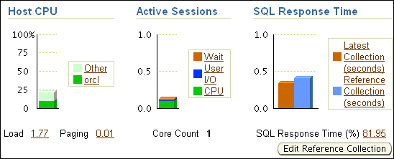
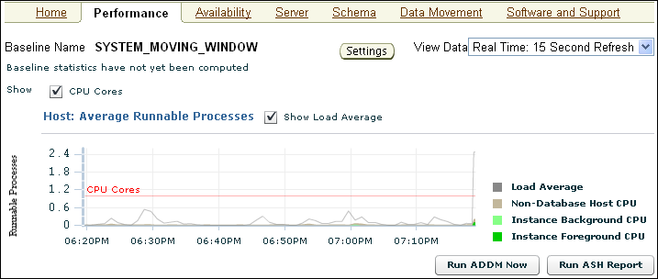
Performance Monitoring
With Enterprise Manager:
  Performance overview
  Graphs of metrics and
  details
Notes:
Performance Monitoring
You can respond to changes in performance only if you know the performance has changed. Oracle Database 11g provides several ways to monitor the current performance of the database instance. The database home page of Enterprise Manager (EM) provides a quick check of the health of the instance and the server, with graphs showing CPU usage, active sessions, and SQL response time. The home page also shows any alerts that have been triggered.
The Performance tab in EM shows several graphs of performance metrics from several directions. You can see performance in terms of CPU, average active sessions, throughput, I/O, and other dimensions. From the Performance page, you can follow links to detailed information: including sessions and individual SQL statements.
The information displayed in EM is based on performance views that exist in the database. You can access these views directly with SQL*Plus. Occasionally, you may need to access these views for some detail about the raw statistics.

Slide 9

Performance Tuning Data
Type of data gathered:
  Cumulative statistics:
    Wait events with time information
    Time model
  Metrics: Statistic rates
  Sampled statistics: Active session history
    Statistics by session
    Statistics by SQL
    Statistics by service
    Other dimensions
Notes:
Performance Tuning Data
The Oracle database server software captures information about its own operation. Three major types of data are collected: cumulative statistics, metrics, and sampled statistics.
Cumulative statistics are counts and timing information of a variety of events that occur in the database server. Some are quite important, such as buffer busy waits. Others have little impact on tuning, such as index block split. The most important events for tuning are usually the ones showing the greatest cumulative time values. The statistics in Oracle Database 11g are correlated by the use of a time model. The time model statistics are based on a percentage of DB time, giving them a common basis for comparison.
Metrics are statistic counts per unit. The unit could be time (such as seconds), transaction, or session. Metrics provide a base to proactively monitor performance. You can set thresholds on a metric causing an alert to be generated. For example, you can set thresholds for when the reads per millisecond exceed a previously recorded peak value or when the archive log area is 95% full.
Sampled statistics are gathered automatically when STATISTICS_LEVEL is set to TYPICAL or ALL. Sampled statistics allow you to look back in time. You can view session and system statistics that were gathered in the past, in various dimensions, even if you had not thought of specifying data collection for these beforehand.

Slide 10
Optimizer Statistics Collection
  SQL performance tuning: Depends on collection of accurate statistics
  Optimizer statistics:
    Object statistics
    Operating system statistics
  Ways to collect statistics:
    Automatically: Automatic Maintenance Tasks
    Manually: DBMS_STATS package
    By setting database initialization parameters
    By importing statistics from another database
Notes:
Optimizer Statistics Collection
Optimizer statistics are collections of data that are specific details about database objects. These statistics are essential for the query optimizer to choose the best execution plan for each SQL statement. These statistics are gathered periodically and do not change between gatherings.
The recommended approach to gathering optimizer statistics is to allow the Oracle database to automatically gather the statistics. The Automatic Maintenance Tasks can be created automatically at database creation time and is managed by the Scheduler. It gathers statistics on all objects in the database that have either missing or stale optimizer statistics by default. You can change the default configuration through the Automatic Maintenance Tasks page.
System statistics describe the system’s hardware characteristics, such as I/O and CPU performance and utilization, to the query optimizer. When choosing an execution plan, the optimizer estimates the I/O and CPU resources required for each query. System statistics enable the query optimizer to more accurately estimate I/O and CPU costs, and thereby choose a better execution plan. System statistics are collected using the DBMS_STATS.GATHER_SYSTEM_STATS procedure. When the Oracle database gathers system statistics, it analyzes system activity in a specified period of time. System statistics are not automatically gathered. Oracle Corporation recommends that you use the DBMS_STATS package to gather system statistics.

Slide 11
Notes:
Optimizer Statistics Collection (continued)
If you choose not to use automatic statistics gathering, then you must manually collect statistics in all schemas, including system schemas. If the data in your database changes regularly, you also need to gather statistics regularly to ensure that the statistics accurately represent characteristics of your database objects. To manually collect statistics, use the DBMS_STATS package. This PL/SQL package is also used to modify, view, export, import, and delete statistics.
You can also manage optimizer and system statistics collection through database initialization parameters. For example:
The OPTIMIZER_DYNAMIC_SAMPLING parameter controls the level of dynamic sampling performed by the optimizer. You can use dynamic sampling to estimate statistics for tables and relevant indexes when they are not available or are too out of date to trust. Dynamic sampling also estimates single-table predicate selectivity when collected statistics cannot be used or are likely to lead to significant errors in estimation.
The STATISTICS_LEVEL parameter controls all major statistics collections or advisories in the database and sets the statistics collection level for the database. The values for this parameter are BASIC, TYPICAL, and ALL. You can query the V$STATISTICS_LEVEL view to determine which parameters are affected by the STATISTICAL_LEVEL parameter.
Note: Setting STATISTICS_LEVEL to BASIC disables many automatic features and is not recommended.

Slide 12


Statistic Preferences: Overview
Optimizer
statistics
gathering
task
Statement level
Table level
DBA_TAB_STAT_PREFS
Schema level
Database level
Global level
CASCADE
DEGREE
ESTIMATE_PERCENT
METHOD_OPT
NO_INVALIDATE
GRANULARITY
PUBLISH
INCREMENTAL
STALE_PERCENT
set_global_prefs
set_database_prefs
DBMS_STATS
set_schema_prefs
set | get | delete
export | import
set_table_prefs
gather_*_stats
DBA
Notes:
Statistic Preferences: Overview
The automated statistics-gathering feature was introduced in Oracle Database 10g, Release 1 to reduce the burden of maintaining optimizer statistics. However, there were cases where you had to disable it and run your own scripts instead. One reason was the lack of object-level control. Whenever you found a small subset of objects for which the default gather statistics options did not work well, you had to lock the statistics and analyze them separately by using your own options. For example, the feature that automatically tries to determine adequate sample size (ESTIMATE_PERCENT=AUTO_SAMPLE_SIZE) does not work well against columns that contain data with very high frequency skews. The only way to get around this issue was to manually specify the sample size in your own script.
Note: You can describe all the effective statistics preference settings for all relevant tables by using the DBA_TAB_STAT_PREFS view.

Slide 13
Using Statistic Preferences
  PUBLISH: Used to decide whether to publish the statistics to the dictionary or to store them in a pending area before
  STALE_PERCENT: Used to determine the threshold level at which an object is considered to have stale statistics. The value is a percentage of rows modified since the last statistics gathering.
  INCREMENTAL: Used to gather global statistics on partitioned tables in an incremental way
exec dbms_stats.set_table_prefs('SH','SALES','STALE_PERCENT','13');
Notes:
Oracle Database 11g: Administration Workshop II 14 - <number>
Using Statistic Preferences
The Statistic Preferences feature in Oracle Database 11g introduces flexibility so that you can rely more on the automated statistics-gathering feature to maintain the optimizer statistics when some objects require settings that are different from the database default.
This feature allows you to associate the statistics-gathering options that override the default behavior of the GATHER_*_STATS procedures and the automated Optimizer Statistics Gathering task at the object or schema level. You can use the DBMS_STATS package to manage the gathering statistics options.
You can set, get, delete, export, and import those preferences at the table, schema, database, and global levels. Global preferences are used for tables that do not have preferences, whereas database preferences are used to set preferences on all tables.
The following options are new in Oracle Database 11g, Release 1:
PUBLISH is used to decide whether to publish the statistics to the dictionary or to store them in a pending area before.
STALE_PERCENT is used to determine the threshold level at which an object is considered to have stale statistics. The value is a percentage of rows modified since the last statistics gathering. The example changes the 10 percent default to 13 percent for SH.SALES only.
INCREMENTAL is used to gather global statistics on partitioned tables in an incremental way.

Slide 14
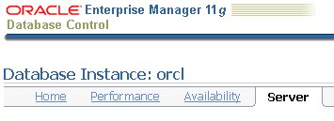
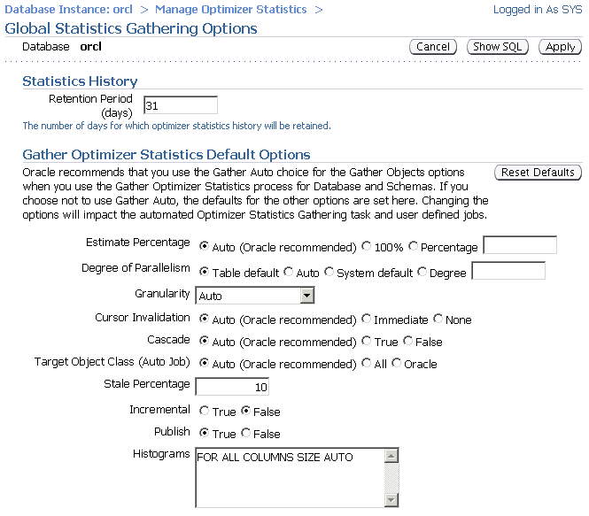

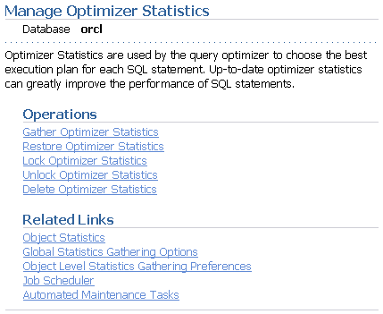
Setting Global Preferences with Enterprise Manager
Notes:
Setting Global Preferences with Enterprise Manager
It is possible to control global preference settings by using Enterprise Manager. You do so on the Manage Optimizer Statistics page, which you access from the Database home page by clicking the Server tab, then the Manage Optimizer Statistics link, and then the Global Statistics Gathering Options link.
On the Global Statistics Gathering Options page, change the global preferences in the Gather Optimizer Statistics Default Options section. When finished, click the Apply button.
Note: To change the statistics gathering options at the object level or schema level, click the Object Level Statistics Gathering Preferences link on the Manage Optimizer Statistics page.

Slide 15
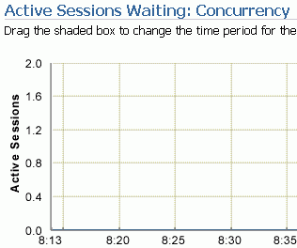
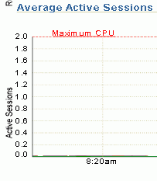
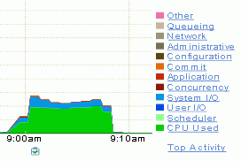
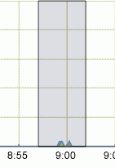

Oracle Wait Events
  A collection of wait events provides information
  about the sessions or processes that had to wait or must wait for different reasons.
  These events are listed in the V$EVENT_NAME view.
Notes:
Oracle Wait Events
Wait events are statistics that are incremented by a server process or thread to indicate that it had to wait for an event to complete before being able to continue processing. Wait event data reveals various symptoms of problems that might be impacting performance, such as latch contention, buffer contention, and I/O contention. Remember that these are only symptoms of problems, not the actual causes.
Wait events are grouped into classes. The wait event classes include: Administrative, Application, Cluster, Commit, Concurrency, Configuration, Idle, Network, Other, Scheduler, System I/O, and User I/O.
There are more than 800 wait events in the Oracle database, including free buffer wait, latch free, buffer busy waits, db file sequential read, and db file scattered read.
Using EM, you can view wait events by opening the Performance page and viewing the “Average Active Sessions” graph, as shown in the slide. By clicking the link for a particular wait event class, you can drill down to the specific wait events by using the Top Activity interface. In this example, there was a very small set of buffer busy waits.
For a list of the most common Oracle events, refer to the Oracle Database Reference 11g documentation.

Slide 16
Instance Statistics
V$SYSSTAT
statistic#
name
class
value
stat_id
V$SYSTEM_WAIT_CLASS
wait_class_id
wait_class#
wait_class
total_waits
time_waited
V$SGASTAT
pool
name
bytes
V$EVENT_NAME
event_number
event_id
name
parameter1
parameter2
parameter3
wait_class
V$SYSTEM_EVENT
event
total_waits
total_timeouts
time_waited
average_wait
time_waited_micro
Notes:
Instance Statistics
To effectively diagnose performance problems, statistics must be available. The Oracle database instance generates many types of cumulative statistics for the system, sessions, and individual SQL statements at the instance level. The Oracle database also tracks cumulative statistics on segments and services. When analyzing a performance problem in any of these scopes, you typically look at the change in statistics (delta value) over the period of time you are interested in.
Note: Instance statistics are dynamic and are reset at every instance startup. These statistics can be captured at a point in time and held in the database in the form of snapshots.
Wait Events Statistics
All the possible wait events are cataloged in the V$EVENT_NAME view.
Cumulative statistics for all sessions are stored in V$SYSTEM_EVENT, which shows the total waits for a particular event since instance startup.
When you are troubleshooting, you need to know whether a process has waited for any resource.
Systemwide Statistics
All the systemwide statistics are cataloged in the V$STATNAME view: Over 400 statistics are available in Oracle Database 11g.
The server displays all calculated system statistics in the V$SYSSTAT view. You can query this view to find cumulative totals since the instance started.

Slide 17
Notes:
Instance Statistics (continued)
Example
SQL> SELECT name, class, value FROM v$sysstat;
NAME CLASS VALUE
------------------------------- ------ ----------
...
table scans (short tables) 64 135116
table scans (long tables) 64 250
table scans (rowid ranges) 64 0
table scans (cache partitions) 64 3
table scans (direct read) 64 0
table scan rows gotten 64 14789836
table scan blocks gotten 64 558542
...
Systemwide statistics are classified by the tuning topic and the debugging purpose. The classes include general instance activity, redo log buffer activity, locking, database buffer cache activity, and so on. Each of the system statistics can belong to more than one class, so you cannot do a simple join on V$SYSSTATS.CLASS and V$SYSTEM_WAIT_CLASS.WAIT_CLASS#.
You can also view all wait events for a particular wait class by querying V$SYSTEM_WAIT_CLASS, as in this example (with formatting applied):
SQL> SELECT * FROM V$SYSTEM_WAIT_CLASS
2 WHERE wait_class LIKE '%I/O%';
CLASS_ID CLASS# WAIT_CLASS TOTAL_WAITS TIME_WAITED
---------- ------ ------------ ----------- -----------
1740759767 8 User I/O 1119152 39038
4108307767 9 System I/O 296959 27929
SGA Global Statistics
The server displays all calculated memory statistics in the V$SGASTAT view. You can query this view to find cumulative totals of detailed SGA usage since the instance started, as in the following example:
SQL> SELECT * FROM v$sgastat;
POOL NAME BYTES
------ ------------------------- ----------
fixed_sga 7780360
buffer_cache 25165824
log_buffer 262144
shared pool sessions 1284644
shared pool sql area 22376876
...
The results shown are only a partial display of the output.
When the STATISTICS_LEVEL parameter is set to BASIC, the value of the TIMED_STATISTICS parameter defaults to FALSE. Timing information is not collected for wait events and much of the performance-monitoring capability of the database is disabled. The explicit setting of TIMED_STATISTICS overrides the value derived from STATISTICS_LEVEL.

Slide 18
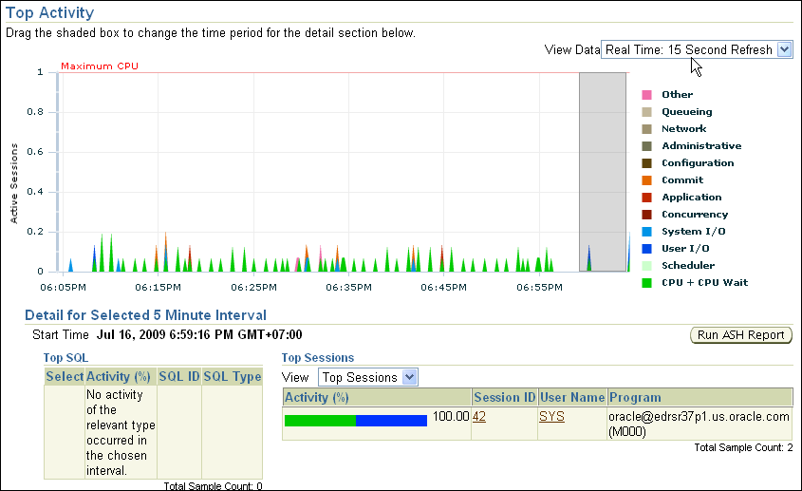
Monitoring Session Performance
Notes:
Monitoring Session Performance
Enterprise Manager provides session detail pages so that you can view the wait events occurring in individual sessions. On the Performance tabbed page, click Top Activity to view the summary of all sessions. In the lower right corner of the Top Activity page is a listing of the Top Sessions. Click the session identifier to view the Session Details page.
The Top Activity page and Session Details page are based on performance view in the database.

Slide 19
Displaying Session-Related Statistics
V$STATNAME
statistic#
name
class
V$SESSTAT
sid
statistic#
value
V$SESSION
sid
serial#
username
command
osuser
seq#
event#
event
p1/2/3text
p1/2/3
p1/2/3raw
wait_class
wait_time
seconds_in_wait
state
...
V$SESSION_EVENT
sid
event
total_waits
total_timeouts
time_waited
average_wait
max_wait
time_waited_micro
event_id
V$EVENT_NAME
event#
name
parameter1
parameter2
parameter3
Notes:
Displaying Session-Related Statistics
You can display current session information for each user logged on by querying V$SESSION. For example, you can use V$SESSION to determine whether a session represents a user session, or was created by a database server process (BACKGROUND).
You can query either V$SESSION or V$SESSION_WAIT to determine the resources or events for which active sessions are waiting.
You can view user session statistics in V$SESSTAT. The V$SESSION_EVENT view lists information about waits for an event by a session.
Cumulative values for instance statistics are generally available through dynamic performance views, such as V$SESSTAT and V$SYSSTAT. Note that the cumulative values in dynamic views are reset when the database instance is shut down.
The V$MYSTAT view displays the statistics of the current session.
You can also query V$SESSMETRIC to display the performance metric values for all active sessions. This view lists performance metrics such as CPU usage, number of physical reads, number of hard parses, and the logical read ratio.

Slide 20
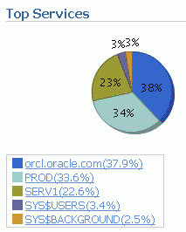
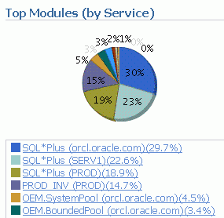
Displaying Service-Related Statistics
For n-tier environments, because session statistics are not as helpful, you can see service-level statistics in these views:
  V$SERVICE_EVENT: Aggregated wait counts and wait times for each service, on a per event basis
  V$SERVICE_WAIT_CLASS: Aggregated wait counts and wait times for each service on a wait class basis
Notes:
Displaying Service-Related Statistics
In an n-tier environment where there is an application server that is pooling database connections, viewing sessions may not provide the information you need to analyze performance. Grouping sessions into service names enables you to monitor performance more accurately. These two views provide the same information that their like-named session counterparts provide, except that the information is presented at the service level rather than at the session level.
V$SERVICE_WAIT_CLASS shows wait statistics for each service, broken down by wait class.
V$SERVICE_EVENT shows the same information as V$SERVICE_WAIT_CLASS, except that it is further broken down by event ID.
Enterprise Manager also provides aggregation by service and by module and service. You can click the legend in each of the views, to view the activity and statistics for each service.
You can define a service in the database by using the DBMS_SERVICE package and use the net service name to assign applications to a service.

Slide 21
Troubleshooting and Tuning Views
Instance/Database
V$DATABASE
V$INSTANCE
V$PARAMETER
V$SPPARAMETER
V$SYSTEM_PARAMETER
V$PROCESS
V$BGPROCESS
V$PX_PROCESS_SYSSTAT
V$SYSTEM_EVENT
Disk
V$DATAFILE
V$FILESTAT
V$LOG
V$LOG_HISTORY
V$DBFILE
V$TEMPFILE
V$TEMPSEG_USAGE
V$SEGMENT_STATISTICS
Contention
V$LOCK
V$UNDOSTAT
V$WAITSTAT
V$LATCH
Memory
V$BUFFER_POOL_STATISTICS
V$LIBRARYCACHE
V$SGAINFO
V$PGASTAT
Notes:
Troubleshooting and Tuning Views
The slide lists some of the views you may need to access to determine the cause of performance problems or analyze the current status of your database. Many of these views show the same data that is used in creating the reports that the Enterprise Manager produces from the Automatic Workload Repository (AWR). In some cases, the raw data is needed to fully diagnose a problem.
For a complete description of these views, refer to the Oracle Database Reference Manual.

Slide 22
Dictionary Views
  The following dictionary and special views display object statistics after use of the DBMS_STATS package:
    DBA_TABLES, DBA_TAB_COLUMNS
    DBA_CLUSTERS
    DBA_INDEXES
    DBA_TAB_HISTOGRAMS
  This statistical information is static until you reexecute the appropriate procedures in DBMS_STATS.
Notes:
Dictionary Views
When you need to look at the optimizer statistics of specific database objects in detail, use the DBMS_STATS package, which collects statistics and populates columns in some DBA_xxx views.
DBMS_STATS populates columns in the views concerned with:
Table data storage within extents and blocks:
DBA_TABLES
DBA_TAB_COLUMNS
Cluster data storage within extents and blocks:
DBA_CLUSTERS
Index data storage within extents and blocks, and index usefulness:
DBA_INDEXES
Nonindexed and indexed columns data distribution:
DBA_TAB_HISTOGRAMS
For more information about using the DBMS_STATS package, refer to the Oracle Database Performance Tuning Guide.
Performing an ANALYZE INDEX … VALIDATE STRUCTURE command populates the INDEX_STATS and INDEX_HISTOGRAM views that contain statistics for indexes.

Slide 23


Automatic Workload Repository
MMON
ADDM finds
top problems.
SYSAUX
SGA
6:00 AM
Snapshot 1
In-memory
statistics
7:00 AM
Snapshot 2
8:00 AM
Snapshot 3
9:00 AM
Snapshot 4
9:30 AM
Notes:
Oracle Database 11g: Administration Workshop II 14 - <number>
Automatic Workload Repository
The Automatic Workload Repository (AWR) is a collection of persistent system performance statistics owned by SYS. The AWR resides in the SYSAUX tablespace.
A snapshot is a set of performance statistics captured at a certain time and stored in the AWR. Each snapshot is identified by a snapshot sequence number (snap_id) that is unique in the AWR. By default, snapshots are generated every 60 minutes. You can adjust this frequency by changing the snapshot INTERVAL parameter. Because the database advisors rely on these snapshots, be aware that adjustment of the interval setting can affect diagnostic precision. For example, if the INTERVAL is set to 4 hours, you may miss transient events that would be noticeable in 60-minute intervals.
You can use the DBMS_WORKLOAD_REPOSITORY.MODIFY_SNAPSHOT_SETTINGS stored procedure or Database Control to change the settings that control snapshot collection. In Database Control, click Automatic Workload Repository in the Statistics Management region of the Server tabbed page. Then click Edit to make the changes. The stored procedure offers more flexibility in defining INTERVAL values than does Database Control.
You can take manual snapshots by using Database Control or the DBMS_WORKLOAD_REPOSITORY.CREATE_SNAPSHOT stored procedure. Taking manual snapshots is supported in conjunction with the automatic snapshots that the system generates. Manual snapshots are expected to be used when you want to capture the system behavior at two specific points in time that do not coincide with the automatic schedule.

Slide 24
Notes:
Oracle Database 11g: Administration Workshop II 14 - <number>
Automatic Workload Repository (continued)
Statspack is a bundled utility that provides a subset of the collection and reporting capability of the AWR. However, there is no supported path to migrate Statspack data into the workload repository. Also, the workload repository is not compatible with the Statspack schema. Statspack is not accessible through Enterprise Manager; it requires setup, and does not have automatic retention settings, or automatic purge. The Statspack utility does provide scripts for setup, automatic snapshot collection, and reporting. Statspack snapshots can be marked for retention, as part of a Statspack baseline, or purged with provided scripts.
Statspack is documented in the $ORACLE_HOME/rdbms/admin/spdoc.txt file.

Slide 25
Using Automatic Workload Repository Views
  DBA_HIST_DB_CACHE_ADVICE
  DBA_HIST_DISPATCHER
  DBA_HIST_DYN_REMASTER_STATS
  DBA_HIST_IOSTAT_DETAIL
  DBA_HIST_SHARED_SERVER_SUMMARY
Notes:
Oracle Database 11g: Administration Workshop II 14 - <number>
Using New Automatic Workload Repository Views
The following AWR statistics views are available in Oracle Database 11g R2:
DBA_HIST_DB_CACHE_ADVICE: Displays historical predictions of the number of physical reads for the cache size corresponding to each row
DBA_HIST_DISPATCHER: Displays historical information for each dispatcher process at the time of the snapshot
DBA_HIST_DYN_REMASTER_STATS: Displays statistical information about the dynamic remastering process
DBA_HIST_IOSTAT_DETAIL: Displays historical I/O statistics aggregated by file type and function
DBA_HIST_SHARED_SERVER_SUMMARY: Displays historical information for shared servers, such as shared server activity, common queues, and dispatcher queues

Slide 26



Real Application Testing Overview:
Database Replay
Database Replay:
  Captures production workloads
  Tests with realistic workloads
  Replays the same SQL against the same data in each test
Workload
Capture
Replay
Production
database
Test
database
Notes:
Real Application Testing Overview: Database Replay
The system is going to change. The hardware must be upgraded, or the operating system, or the database version, or all of them. You have to assure the users that the application will continue to function after the upgrade, and often guarantee performance at least as good as it was before the upgrade.
You build a test environment and test the application with a workload. You make changes and test again until you are confident that the application is working in the new environment.
This whole process depends on the test workload being representative of the actual production workload. A single statement in the production workload missing in the test workload could cause the upgrade to fail in production.
Database Replay captures the actual production workload and allows you to replay the workload in a test environment. The replay can be modified to allow for higher throughput, asynchronous application, and faster or slower replay. Database Replay can also be used to fine-tune by running exactly the same set of statements repeatedly. You can make changes to the environment and observe the differences. This capability also allows capture and replay of test cases to resolve errors.
Using actual production workloads allows you to be confident that the testing process is complete and accurate.

Slide 27
The Big Picture
Prechange production system
Postchange test system
Clients/App servers
Capture directory
Replay
system
Shadow capture file
Shadow capture file
Process capture files
Shadow capture file
Test
system
with
changes
Production
system
Shadow capture file
Production
database
Database
backup
Database
restore
Can use Snapshot Standby as test system
Notes:
The Big Picture
The significant benefit with Oracle Database 11g managing system changes is the added confidence to the business in the success of performing the change. The record and replay functionality offers confidence in the ease of upgrade during a database server upgrade. A useful application of Database Replay is to test the performance of a new server configuration. Suppose you are utilizing a single-instance database and want to move to a Real Application Clusters (RAC) setup. You can record the workload of an interesting period and then set up a RAC test system for replay. During replay, you can monitor the performance benefit of the new configuration by comparing the performance to the recorded system.
Database Replay can be used for debugging. You can record and replay sessions emulating an environment to make bugs more reproducible. Manageability feature testing is another benefit. Self-managing and self-healing systems need to implement this advice automatically (“autonomic computing model”). Multiple replay iterations allow testing and fine-tuning of the control strategies’ effectiveness and stability.
To learn more about this technology, attend the Oracle Database 11g: Performance course.
For more information, see also the Oracle Database Performance Tuning Guide and the Oracle Database PL/SQL Packages and Types Reference.

Slide 28
Quiz
Select the statements that are true about statistics collection:
  You can manually collect statistics with the DBMS_STATS package.
  You can automatically collect statistics by enabling Automatic Maintenance Tasks.
  You can import statistics from another database.
  You can collect statistics by setting database initialization parameters.
  You can collect statistics by manually updating the data dictionary.
Notes:
Answer: 1, 2, 3, 4

Slide 29
Summary
In this lesson, you should have learned how to:
  Monitor the performance of sessions and services
  Describe the benefits of Database Replay

Slide 30
Practice 14 Overview:
Monitoring Instance Performance
This practice covers the following topics:
  Monitoring Top Services and Sessions
Notes:
Oracle Database 11g: Administration Workshop II 14 - <number>

